Slide 1
Unit 2 How often do you exercise?
Section A Grammar Focus-3c
人教版 英语 八年级上册

Slide 2
Learning goals
1.Curriculum words: maybe, least
2. Useful expressions: at least, stay up, how often
3. Functions：谈论从事活动的频率
4. Grammar：①常见频度副词
②单位时间内活动频度次数的表达法
5. Sentences：① —What do you usually do on weekends?
—I always/sometimes/...
② —How often...? —I ... once a month/...
③ —Do you…? —Yes, I do./No, I don't.

Slide 3
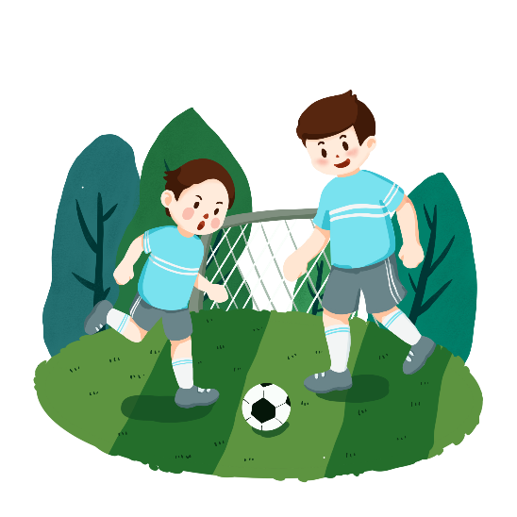
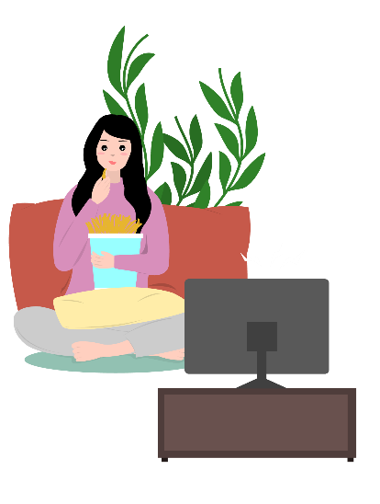
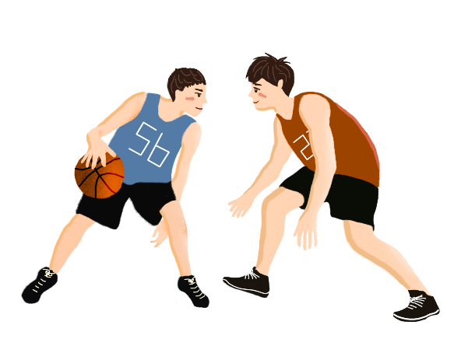
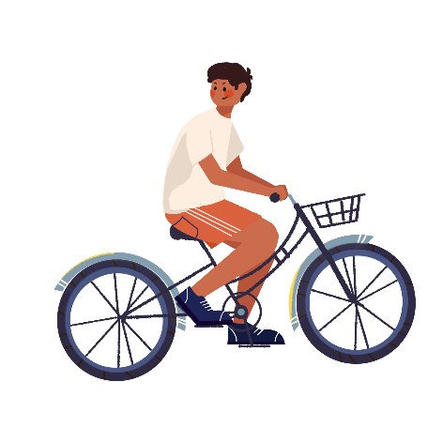
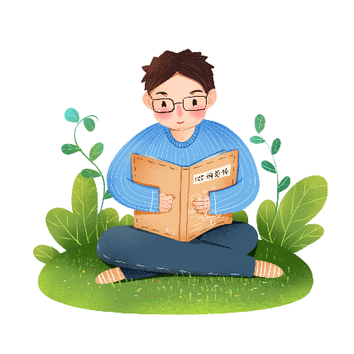

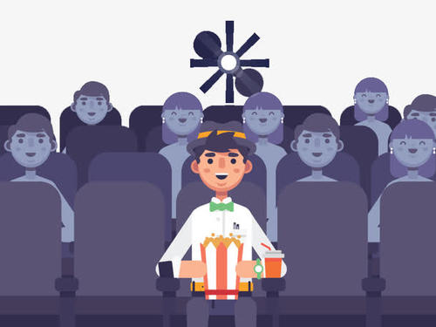
Warming up
Let’s talk about your weekends.
—Do you...?
—Yes, I do. /No, I don’t.
—What do you usually do on weekends?
—I usually watch TV/...
—How often do you watch TV/...?
—Once a week/...

Slide 4





定向自学

Slide 5
Grammar Focus
Circle adverbs of frequency
What do you usually do on weekends? | I always exercise.
What do they do on weekends? | They often help with housework.
What does she do on weekends? | She sometimes goes shopping.
How often do you go to the movies? | I go to the movies maybe once a month.
How often does he watch TV? | He hardly ever watches TV.
Do you go shopping? | No, I never go shopping.

Slide 6
Grammar Focus
Find the expression of frequency per unit time (单位时间内频度)
What do you usually do on weekends? | I always exercise.
What do they do on weekends? | They often help with housework.
What does she do on weekends? | She sometimes goes shopping.
How often do you go to the movies? | I go to the movies maybe once a month.
How often does he watch TV? | He hardly ever watches TV.
Do you go shopping? | No, I never go shopping.

Slide 7
合作研学
&
展示激学
请完成学案上合作研学部分内容，并展示

Slide 8
精讲领学

Slide 9
Grammar Focus
频度副词(frequency adverb)
频度副词表示某一动作或状态出现的频率，即在一定时间内某一动作或状态重复出现的次数，常用来回答how often的提问。
模 糊
频率副词
I always exercise.
No, I never go shopping.
I go to the movies maybe once a month.
精确的
频率副词

Slide 10
Grammar Focus
频度副词的种类
1
不表示具体次数的频度副词（按频率从高到低排列）
always (100%)
总数
>
almost always
几乎总是
>
usually
通常
>
often
经常
sometimes
有时
>
hardly ever(seldom)
几乎从不（很少）
>
never(0%)
从不
We often play basketball after school.
He is never late for class.

Slide 11
Grammar Focus
频度副词的位置
实义动词之前
She always goes to school by bus.
be动词、助动词、情态动词之后
频度副词
I’m always happy to see her.
I can never forget it.
有时为了强调，频度副词也可位于句首。
Sometimes he goes to work by bus.

Slide 12
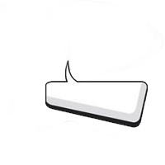
Grammar Focus
频度副词的种类
表示具体的频率、次数时，通常用once a week（一周一次），twice a month（一月两次），three times a year（一年三次）等。
2
I use the Internet twice a week.
Li Ming and his parents go to the park three or four times a month.
句尾

Slide 13

Translate the phrases below：
一小时一次 | 一天两次 | 一周三次
一月一次 | 一年一次 | 一年四次
一天五次 | 一周两次 | 一年六次
once an hour
twice a day
three times a week
once a month
once a year
four times a year
five times a day
twice a week
six times a year

Slide 14
Grammar Focus
Find the questions and answers that ask about the frequency of the activity
What do you usually do on weekends? | I always exercise.
What do they do on weekends? | They often help with housework.
What does she do on weekends? | She sometimes goes shopping.
How often do you go to the movies? | I go to the movies maybe once a month.
How often does he watch TV? | He hardly ever watches TV.
Do you go shopping? | No, I never go shopping.

Slide 15
Grammar Focus
对频度副词的提问
用来提问动作发生的频率，用how often,提问，表示“多久一次”。
—How often does he come here?
—Once a week.
句型结构： How often + 助动词+主语+动词原型+其他

Slide 16
练习
1. I often play football.
_____
How often do you play football?
______
2. She seldom watches TV.
How often does she watch TV?
__________
3. We read English every day.
How often do you read English?
4. David calls me once a week.
____________
How often does David call you?

Slide 17
Presentation
3a
Complete the questions with do or does. Then match the questions and answers.
at least 至少；不少于；起码，一般指数量或程度上
反义词为 at most, 意为 不超过，至多
1. How often ______ he play soccer? a. Yes. She usually does.
2. ______ you drink milk? b. Hardly ever. I don’t like them.
3. How often ______ they stay up late? c. He plays at least twice a week.
4. ______ Sue eat a healthy breakfast? d. No, they don’t. They’re too busy.
5. How often ______ you eat apples? e. Never. They always go to bed early.
6. ______ your parents play sports? f. Yes, I do. Every day.
does
Do
熬夜
do
Does
例句
do
Do
上床睡觉
做运动
You can borrow at most three books once.
Teenagers need to sleep at least 8 hours every day.

Slide 18
Presentation
3b
Use the words given to write questions.Then ask and answer them with a partner.
Questions My partner's answers
1. __________________________________? _________________________
(how often/help with housework)
2. __________________________________? _________________________
(what/usually/do/weekend)
3. __________________________________? __________________________
(how often/best friend/exercise)
4. __________________________________? __________________________
(what/usually/do/after school)
How often do you help with housework
Three times a week.
What do you usually do on weekends
I usually visit my grandparents.
How often does your best friend exercise
He exercises almost every day.
What do you usually do after school
I usually help with cooking.

Slide 19
Presentation
Discussion
What can you do to improve your English?
watch English programs on TV
listen to English news
sing English songs
read English books
…

Slide 20
Presentation
3c
What can you do to improve your English? Add more things to the chart.Then ask your classmates the questions and find the best English student.
How often do you... | Names | Frequency
read English books? | Lin Ying | twice a week
A: How often do you read English books?
B: I read English books about twice a week.

Slide 21
反馈固学

Slide 22
Exercises
一 、单项选择
—_______do you brush your teeth?
—Twice or more a day.
1
D
A. How soon B. How far C. How long D. How often
—I heard you made a new family rule “Put away your phone while at home.”
—Yes. We were _______ busy checking our mobile phones before, but now we enjoy communicating with our family.
2
A
A. always B. never C. seldom D. sometimes

Slide 23
Exercises
一 、单项选择
Uncle Liang _______ eats out because his wife always makes delicious food for him.
3
A
A. seldom B. sometimes C. often
—How often does your sister surf the Internet?
—About _______.
4
D
A. three time a day B. three times everyday
C. three time every day D. three times a day

Slide 24
Exercises
三、根据要求回答问题
1
Grace does online shopping four times a month.（对划线部分提问）
How often
does Grace do online shopping？
Mike often goes to the library on Sundays.（对划线部分提问）
2
Mike often on Sundays?
What does do
He usually goes to the movies on weekends.（改为一般疑问句）
3
Does go
he usually to the movies on weekends?

Slide 25
Summary
主语第一人称
主语+动原......
肯定句中不同人称对应的动词变化
主语第三人称
主语+动词三单
一般
现在时
主语第一人称
（疑问词+)Do+主语+动原......?
疑问句中人称主语与助动词的搭配
主语第三人称
（疑问词+)Does+主语+动原......?
always (100%)>>almost always>usually>often>sometimes>
hardly ever(seldom)>never(0%)
不表具体次数
分类
表具体次数、频率
once a week, twice a month, three times a year等
频度副词
一般放在实义动词之前，be动词、助动词、情态动词之后。有时为了强调，频度副词也可位于句首。
位置
对频度副词提问
How often...

Slide 26

Homework
1. Review and recite the usage of simple present tense and frequency adverbs.
2. Make sentences with simple present tense and frequency adverbs, no less than five.
3. Preview the new words and phrases in Section B(1a-1e).

